Slide 1
Pan African Survey Analysis
(The Data Incubator Project)
By
Riya Saluja

Slide 2

Agenda
Objective
Data Overview
Analysis Results
Exploratory Analysis
Clustering
Key Takeaways
Fun Facts

Slide 3

Objective
Analyze the difference in access to communication and media channels among Pan African countries.
Identify the groups of Pan African nationals
Similar perceptions on country’s economy and their living conditions
Similar access to communication and media devices such as TV, Mobile and Radio
Utilize the learnings and insights to inform decisions for profit and non-profit businesses

Slide 4

Data Overview
Pan African Survey Data provided by Afrobarometer
Data size is nearly 52 MB (364 variables and 57K records)
Dataset has individual responses to a survey consists of following categories of questions
Country’s economic and political situation
Access to Services and Facilities
Access to News, Media and Communication Channels
Influenced by foreign countries such as US, India and China

Slide 5
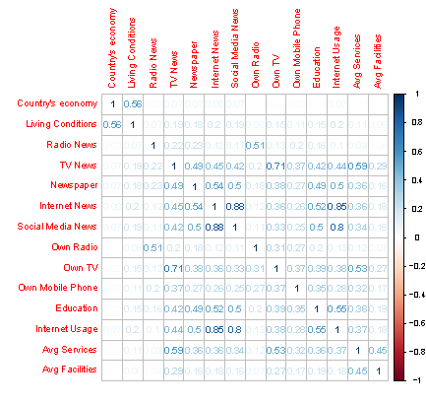

Exploratory analysis
Conducted correlation analysis to find and eliminate highly correlated variables
For example Internet and Social Media Usage (facebook, Twitter) have a strong correlation

Slide 6
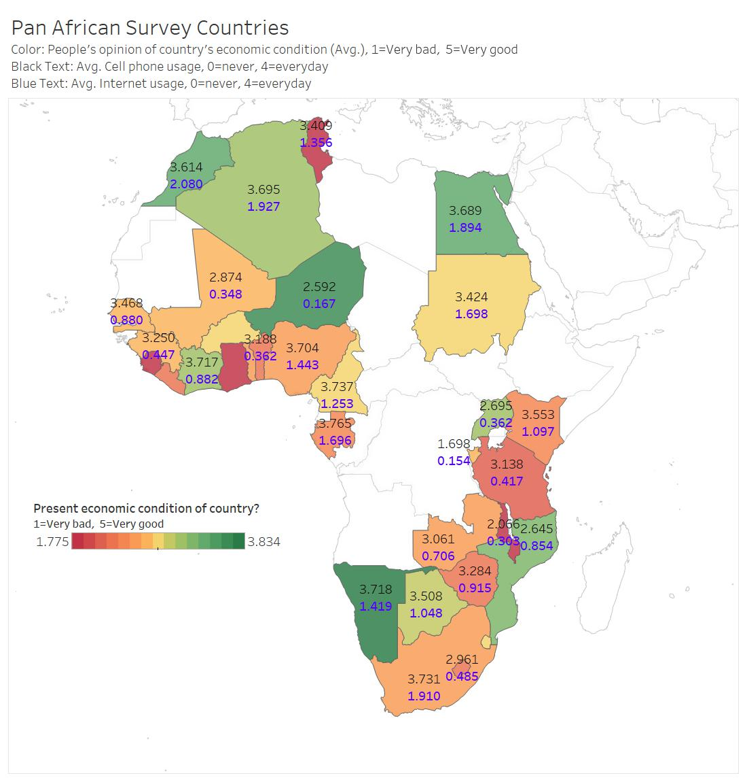
Exploratory analysis
Analyzed the variance in key variables among Pan African countries.
For example mobile phone usage, internet usage and perception on country’s economic condition

Slide 7
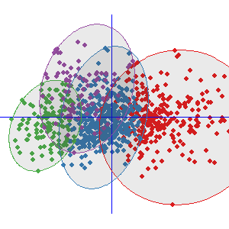
Clustering Overview and Results
Identified 10 clusters of Pan African nationals using k-means algorithm, with similar access to media and communication channels and having similar perception of country’s economic and living conditions
As an example below, cluster 1, 4 and 7 have different profiles relative to each other. Green dot indicates higher propensity.
This Photo by Unknown Author is licensed under CC BY-SA

Slide 8

Key Takeaways
75 % of survey population has mobile phone whereas only 10 %of them use internet everyday.
4 out 10 clusters have high mobile usage
Businesses could develop unique strategies aligned to clusters’ profile e.g. companies can invest in providing low cost internet options in the areas with high mobile usage.
Significant diversity exists across clusters for access to news media
3 out of 10 clusters have high consumption of Radio news but low social media and TV.
Profit and Non-profit companies can use a unique set of communication channel to reach the right audience cluster

Slide 9

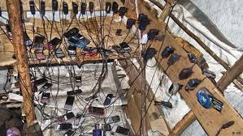
Fun Facts
Few groups have mobile phones but don’t have access to basic services and facilities such as school, sewage system, piped water and electricity

Slide 10


Slide 11


Slide 12

Appendix

Slide 13
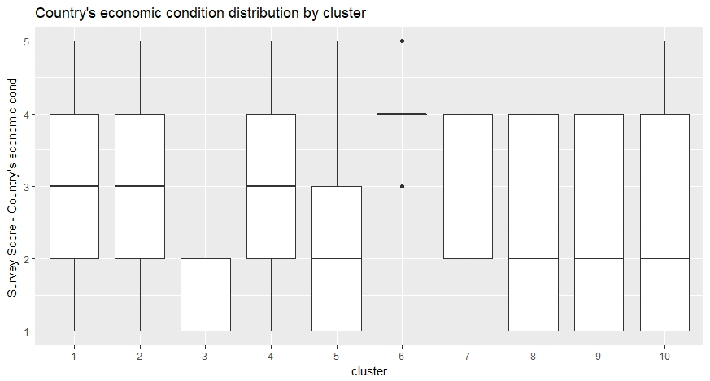
Box Plot

Slide 14
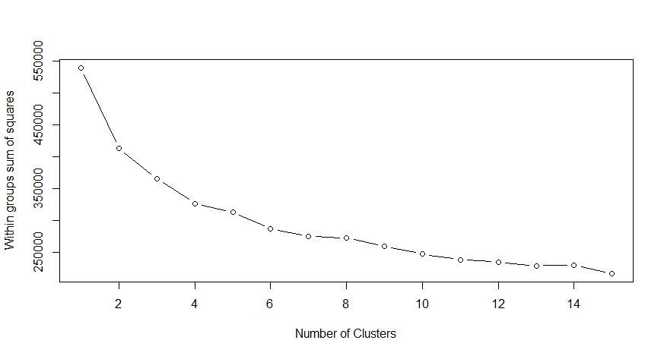
Optimal Number of

